Slide 1
Style Transfer in Text:Exploration and Evaluation

Slide 2
Introduction:
The paper aims to achieve stylistic transfer (i.e. writing content from one author in the writing style of another author) without parallel data for cross validation.
Major challenges involved in the task that have been taken up in the paper are lack of parallel data, separating style from content and evaluation.
This paper explores two models: 1.Multi-decoder seq2seq network with an adversarial network. 2.Style embedding model (Similar to the prev one but single decoder augmented with style embeddings)
Both the models are based on neural sequence to sequence model and the common aim is to separate out the style from content representation of an input sentence.

Slide 3
Auto-encoder Seq2Seq Model:
In this model the encoder is trained to generate a latent representation of the input sentence X = (x1, . . . , xTx), of lenght Tx. The decoder is trained to recover the input sequence from the latent representation.
Let w = {w1,...,wT} be a sentence,
hi = f(xi, hi−1)
V = q({h1,...,hT})
Where, xi is the input vector of wi, hi is the hidden state of ith sequence and v is the fixed length vector into which the encoder stores the sentence.
The decoder is trained to maximize the conditional probability of next word, yt, given fixed vector v.
p(ˆy) = T′∏t=1 p(ˆyt|{ˆy1,...,ˆyt−1}, v)

Slide 4
Encoder:
S = Encoder(x ; Θe)
Decoder:
P(yi | xi ; Θd) = Ty∏j=1 p(yi,j | Encoder(xi; Θe), yi,1,..., yi,j−1 ; Θd)
Loss function for the encoder-decoder minimizes the negative log probability of the training data(of size M), Θe and Θd are the parameters of encoder and decoder respectively.
Lseq2seq (Θe,Θd) = −M∑i=1 log P(yi|xi; Θe,Θd)
In an auto-encoder we let the output sequence y to be the same as the input sequence x.

Slide 5
Multi-decoder model:
The challenge of this model is to generate content c from input x. In the original auto-encoder the encoder generates representations that contain both content and style information. The Multi-decoder model is similar to an auto-encoder with several decoders, with the exception that the encoder now tries to learn some content representations that do not reflect styles.
Adversarial networks can be used to separate the shared and the private features. Here we use an adversarial network to separate content from style. The adversarial network contains two parts: Generator and Discriminator

Slide 6
Discriminator: The loss function minimizes the negative log probability of style labels in the training data.
Ladv1(Θc) = −M∑i=1 logp( li | Encoder(xi; Θe); Θc)
Where, Θc is the parameter of a multi-layer perceptron for predicting style labels.
Generator: The loss function aims at making the discriminator unable to identify the style of x by maximizing the entropy of the predicted style labels.
Ladv2(Θe) =−M∑i=1N∑j=1H(p(j|Encoder(xi; Θe); Θc))
Decoder: The loss function for each decoder is Lseq2seq and the total loss is given by,
Lgen1(Θe,Θd) = L∑i=1 Liseq2seq(Θe, Θi,d)
The final loss function of the multi-decoder model is composed of three parts: two for the adversarial network and one for the seq2seq generation.
Ltotal1(Θe,Θd,Θc )= Lgen1(Θe,Θd) +Ladv1(Θc) +Ladv2(Θe)

Slide 7
Style Embedding model:
In this model, the encoder and the adversarial network parts are the same as the previous model, to generate content representation c.
In addition, style embeddings E ∈RN×ds are introduced to represent styles where, N is the number of styles and ds is the dimension of the style embedding.
A single decoder is trained in this model, which takes the concatenation of the content representation c and style embedding e of a input sentence to generate text in different styles.
The difference in loss functions between the models is that the loss function for style embeddings contains a different generation loss which contains a parameter for style embeddings E. The loss function for this model is,
Ltotal2(Θe,Θd,Θc )= Lgen2(Θe,Θd,E) +Ladv1(Θc) +Ladv2(Θe)

Slide 8
Parameter Estimation:
Learning rate : 0.0001
Batch-size : 128
Number of epochs for positive-negative dataset : 10
Evaluation:
Transfer strength: We use a LSTM-sigmoid classifier(based on keras examples) to classify the output into different styles and transfer strength is defined as the ratio of no.of cases of correct style transfer to total no.of cases.
Content preservation: This is essential because in its absence the model would achieve 100% transfer strength by only generating the target style words. Content preservation rate is defined as the cosine distance between the source sentence embedding vs and the target sentence embedding vt. Sentence embedding consists of max, min, mean pooling of word embeddings.

Slide 9
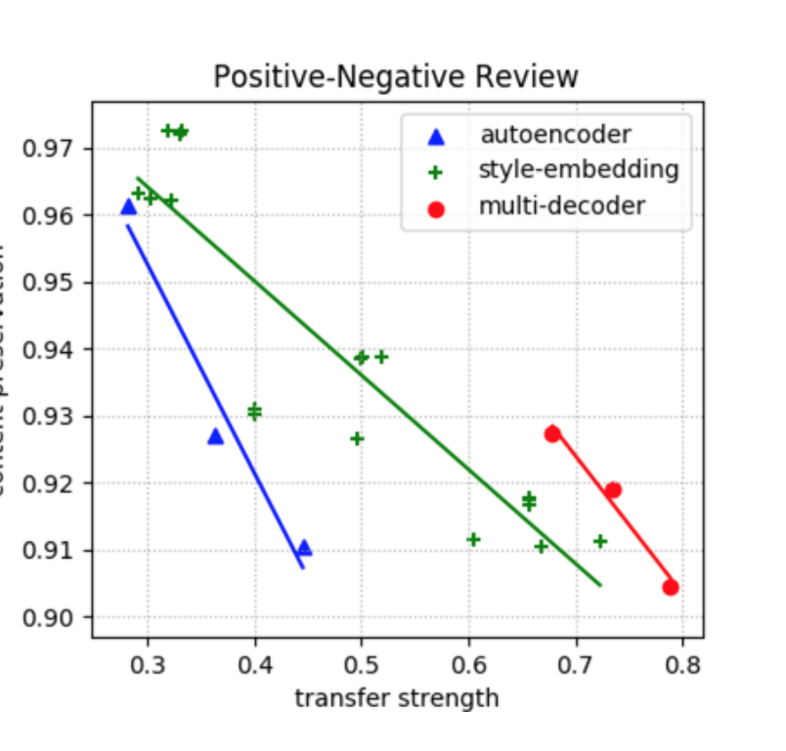

Slide 10
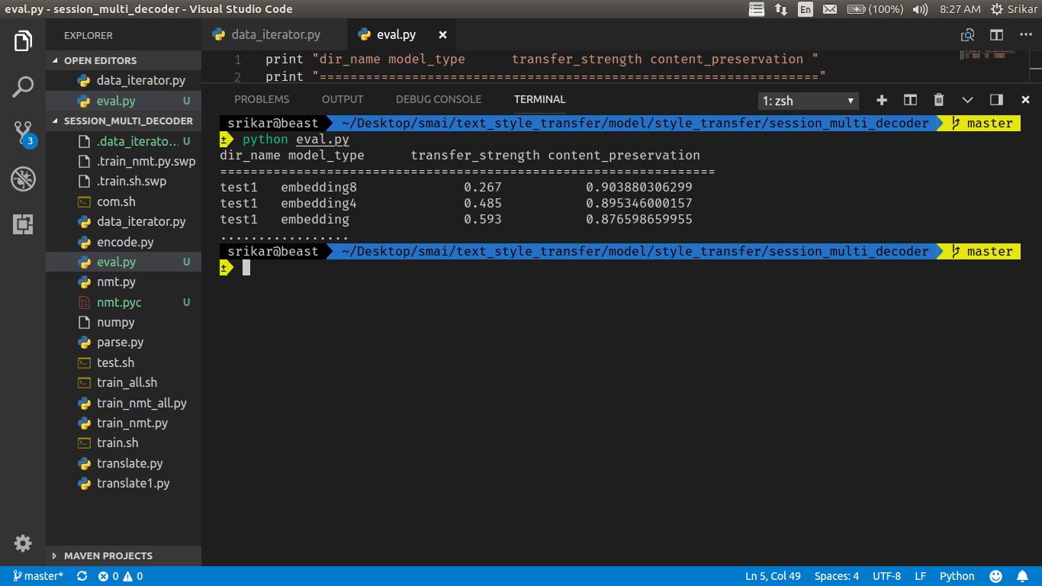
Results:

